Slide 1
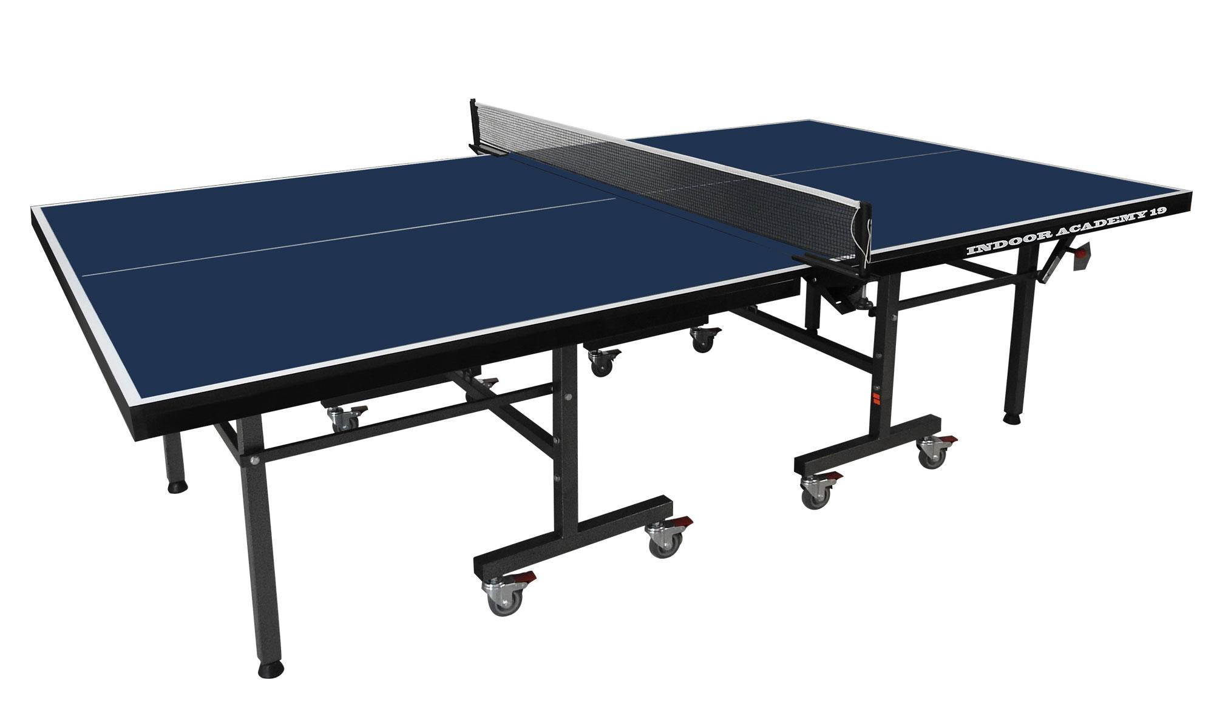
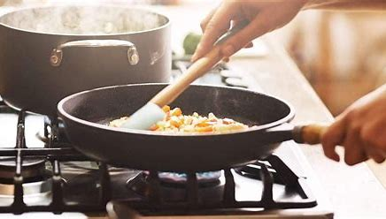
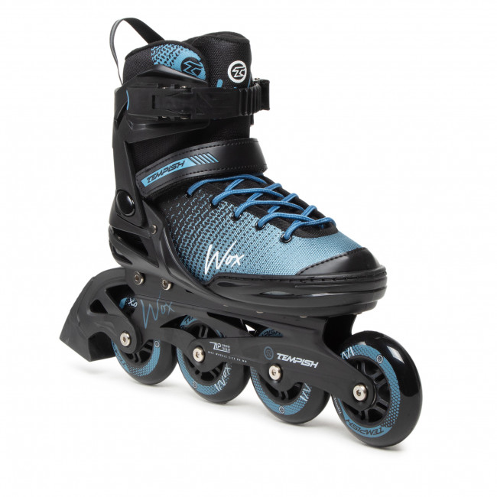
I LIKE TO PLAY TABLE TENIS
I hate skating.
I love cooking, but I hate cleaning up.

